Slide 1
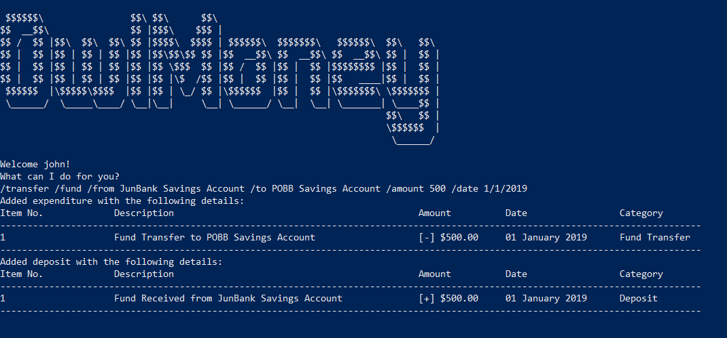
Successful transfer between two savings account
Command entered

Slide 2
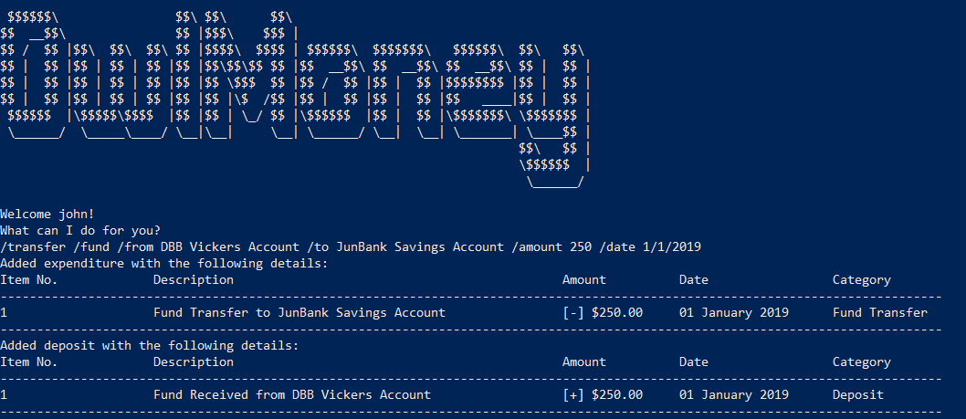
Successful transfer between savings and investment account
Command entered

